Slide 1



Follow along / access resources?:
08/Sept/2026: AI in research
Levels of Using AI in Research
From a trainee who knows nothing to a trusted colleague
Sören Kuypers · OBI
github.com/Aptamer1/ai-research-day-08092026

Slide 2

IN THE NEXT 12 MINUTES
Think of AI as a trainee
Trusted colleague
7
6
5
Full control
Loops
Local models
4
Multiple models
agents that iterate on their own
3
one writes, another reviews
Skills & agents
2
trusted with real tasks
Day one
Master context
1
Add context
search & retrieve knowledge
Cold start
hand over files to read
no context, mixed results
Levels of Using AI in Research
2

Slide 3
LEVEL 1 · COLD START
A trainee with zero context
The assignment
(the prompt)
a task, no background, no examples
The trainee
(the LLM)
zero context in the room
The response
(the output)
part genuinely solid, part confidently invented
→
→
A smarter trainee might help — but so do other strategies. The next levels explore them.
Levels of Using AI in Research
LEVEL 1 / 7
3

Slide 4
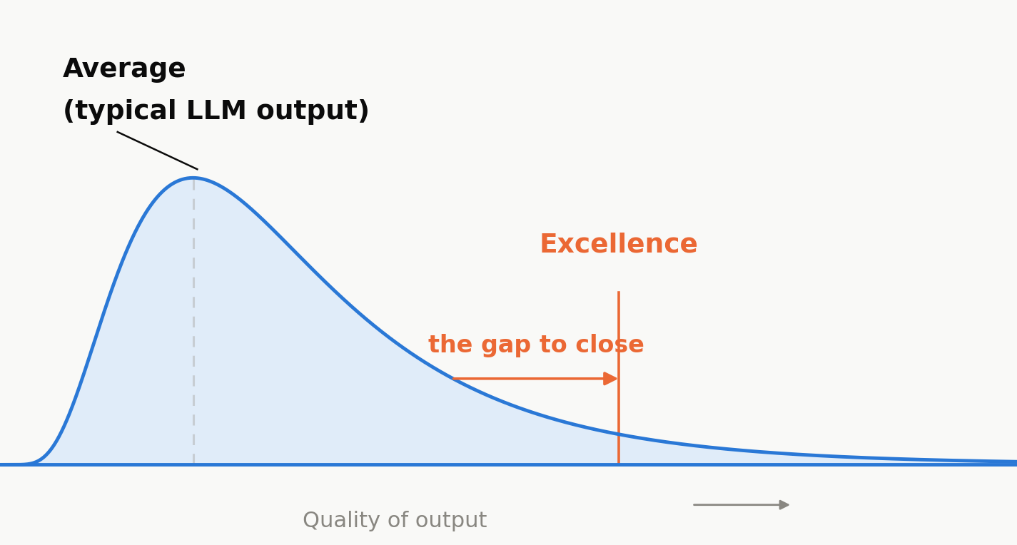
THE PROBLEM
LLMs predict the average. Research needs excellence.
This gap is the challenge — models default to average; research needs the right tail.
The next levels are strategies to close it: context, skills, second opinions, and more — not just a smarter trainee.
Levels of Using AI in Research
4

Slide 5
LEVEL 2 · ADD CONTEXT
Give it something to read
Assignment
(the prompt)
+ Files
The trainee
(the LLM)
The response
(the output)
fewer blanks filled in from guesswork
→
→
Claude: drag a file into the chat — read once, part of this conversation only.
ChatGPT: attach a file to a message — same idea
Copilot: Upload possible, but type “/” in the chat to pull a file straight from SharePoint or OneDrive — no upload needed.
Tip: some models read PDFs and images far better than others — ask a model to summarize a PDF or image into text first.
Tip: attach a strong worked example alongside the assignment — showing what “good” looks like lifts quality more than describing it (few-shot beats instructions alone).
Levels of Using AI in Research
LEVEL 2 / 7
5

Slide 6
LEVEL 3 · MASTER CONTEXT
The context window is the key to better output
CONTEXT WINDOW
The trainee
(the LLM)
The response
(the output)
System prompt
(you can't change this)
standing instructions
Assignment
(user prompt)
what you're asking right now
Files & history
attached content, chat so far
→
→
What's not inside this window doesn't exist to the model
Training still gives it general, averaged knowledge — the window is what makes it specific, current, and checkable.
Levels of Using AI in Research
LEVEL 3 / 7
6
Notes:
Critical nuance behind this slide: an LLM actually has two different kinds of "knowing", and they behave very differently.
1) Parametric knowledge (baked into the weights during training) - this is the huge amount of data it was trained on. It's real, but it's compressed and statistical, not a lookup table. The model doesn't store documents verbatim; it stores patterns and associations distilled from billions of examples. This is also exactly why it defaults to average (slide 4): parametric knowledge is a blend of everything similar it has ever seen, not a precise fact.
2) Contextual knowledge (what's in the window right now) - specific, verbatim, and current. The model can quote it, reason over its exact wording, and treat it as ground truth for this conversation.
Why the context window still matters despite all that training data:
- Frozen in time: training has a cutoff, so it cannot know your specific proposal, this year's call text, or anything that didn't exist (or wasn't public) when it was trained.
- Never saw your specifics: it was never trained on your unpublished draft or your institution's internal criteria - those aren't in there to retrieve, at any resolution.
- Fuzzy, not verbatim: even for things it was trained on, it's recalling a statistical blend, not a citation - ask it to quote exact numbers from memory and it will often confidently invent something plausible (the "confidently invented" line from slide 3).
- Averaged, not excellent: training gives the generic version of "how a grant proposal usually looks"; context is what pulls it away from that average and grounds it in your specific, excellent case.
One-line answer if asked live: what's not in the window doesn't exist to the model as a fact it can verify or quote - only, at best, as a fuzzy statistical guess from training.

Slide 7
LEVEL 3 · MASTER CONTEXT
Instead giving it something to read, let it search through a knowledge base
Assignment
(the prompt)
The trainee
(the LLM)
+ Searches
a knowledge base
The response
(the output)
grounded in what was actually found
→
→
One way to do this is RAG — Retrieval-Augmented Generation: the model searches your documents at question time instead of having them all preloaded.
How to apply?
Claude: Projects auto-expand past the context window on any plan, including free — RAG kicks in automatically for up to 10x more capacity, no setup needed.
ChatGPT: Custom GPTs chunk, embed, and search up to 20 knowledge files at question time (creating one needs ChatGPT Plus).
Copilot Studio: can set this up over a linked SharePoint folder, semantically indexing up to 1,000 files automatically.
Levels of Using AI in Research
LEVEL 3 / 7
7

Slide 8
LEVEL 4 · SKILLS & AGENTS
A skill + tools turns a llm into a specialist (agent)
AGENT
LLM
the brain
Tools
what it can do
Skill
a reusable procedure
A skill is a reusable procedure — instructions, written once, that it follows automatically when relevant.
It doesn't replace the agent; it specializes it — “turns a general-purpose agent into a specialist.”
Open standard: since Dec 2025, SKILL.md is an open standard — the same skill file now works across Claude, ChatGPT, Codex CLI, Gemini, and Copilot.
Levels of Using AI in Research
LEVEL 4 / 7
8

Slide 9
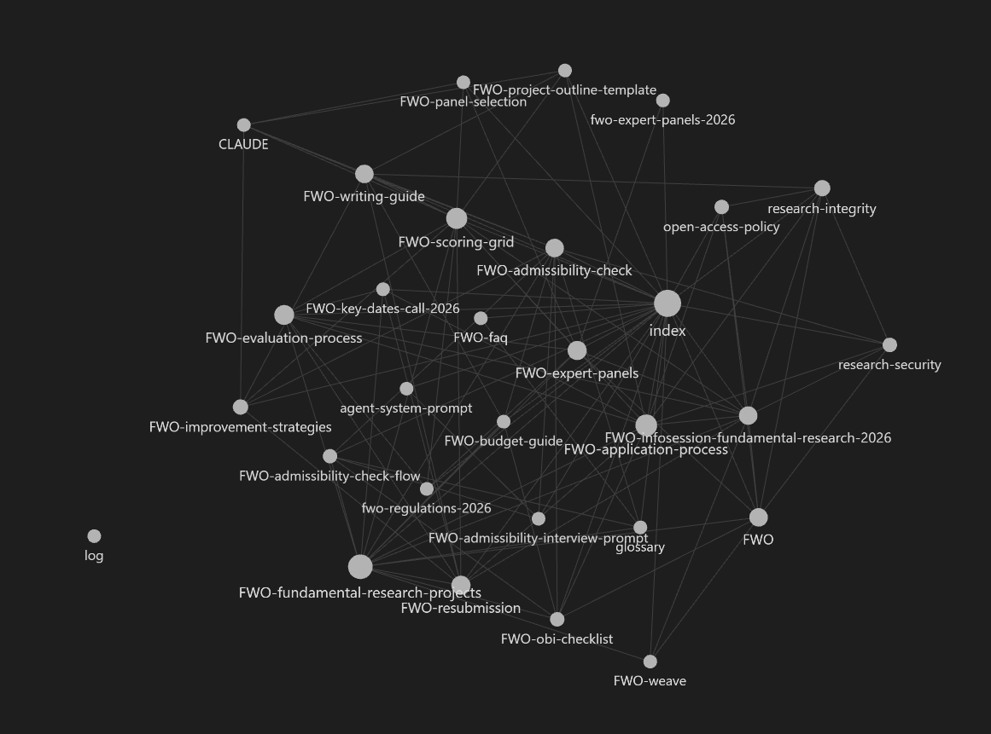
LEVEL 4 · SKILL #1
Give it a memory: the “LLM wiki”
A different way to retrieve knowledge: instead of re-searching raw documents on every question, the LLM compiles a persistent, growing wiki and keeps it current.
THE SKILL
IN PRACTICE
You maintain a persistent markdown wiki instead of answering straight from raw files — sources are read once, then compiled into pages that keep growing.
Structure: raw/ (untouched sources) → wiki/ (the pages you maintain) → a schema file (e.g. CLAUDE.md) that tells you how to file, cross-reference, and answer.
Ingest: when I add a new source, read it, then update the relevant wiki pages — entity pages, topic summaries, an index — and flag anything that contradicts what's already there.
Query: when I ask a question, check the index first, then the pages it points to, and answer with what the wiki already knows — don't start from scratch.
Lint: periodically health-check the wiki for orphan pages, stale claims, and missing cross-references.
Levels of Using AI in Research
LEVEL 4 / 7
9

Slide 10
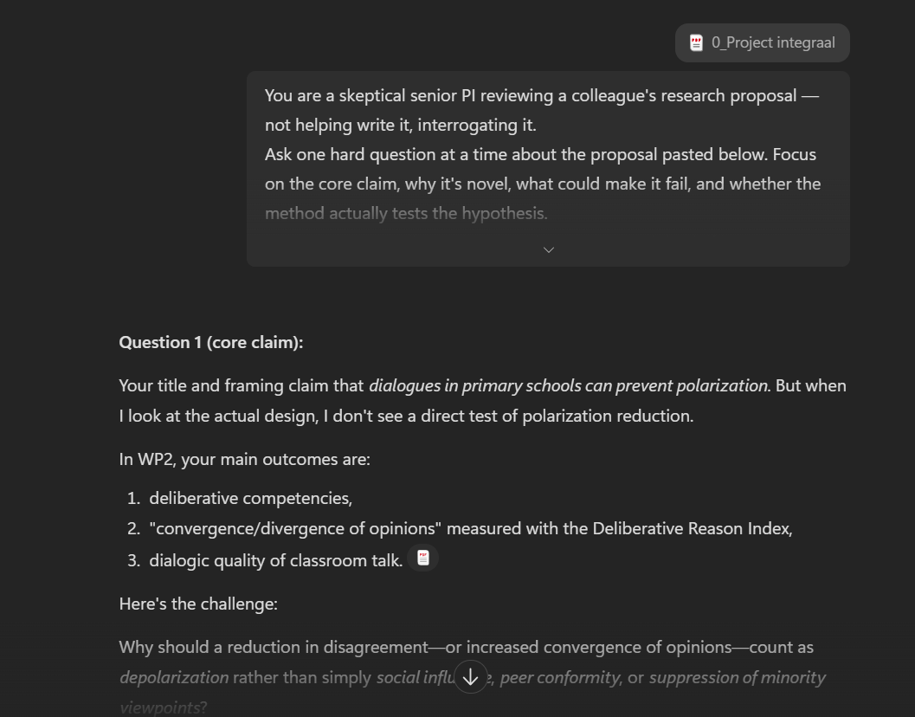
LEVEL 4 · SKILL #2
Grill-me-for-research
Adapted from Matt Pocock's /grill-me coding skill (74k+ GitHub stars) — same idea, aimed at a proposal instead of code.
THE SKILL
IN PRACTICE
You are a skeptical senior PI reviewing a colleague's research proposal — not helping write it, interrogating it.
Ask one hard question at a time about the proposal pasted below/attached. Focus on the core claim, why it's novel, what could make it fail, and whether the method actually tests the hypothesis.
Don't move on until I've given a real answer — push back if it's vague.
Stop after 8-10 questions, then summarize the 3 weakest points still unresolved.
Levels of Using AI in Research
LEVEL 4 / 7
10

Slide 11
LEVEL 4 · SKILL #3
Teach it to stress-test a proposal
Specific assignment
the prompt, not a generic role
The trainee
(the LLM)
+ Search
Knowledge base containing criteria
The response
a structured critique
→
→
Real prompts from Mads Lykke Berggreen — research adviser, VIA University College (Denmark), active in EARMA (European Association of Research Managers and Administrators)'s AI community:
THE CRITICAL REVIEWER
THE BIAS & OMISSION CHECK
Act as a strict Horizon Europe grant evaluator. Read the following draft section of my proposal.
Identify logical gaps, weak impact pathways, and unconvincing methodology claims.
Give me 3 concrete ways to make this argument sharper and more authentic.
Review this project concept text.
Highlight any invisible blind spots, lack of inclusivity, or underrepresented stakeholder perspectives that a human panel might penalize.
Same pattern works with your own checklist — e.g. OBI's admissibility criteria.
Levels of Using AI in Research
LEVEL 4 / 7
11

Slide 12
LEVEL 4 · SKILL #4
From FWO's rulebook to a pressure-tested proposal
Every level from this talk, chained on one funder: raw files become a searchable knowledge base, then a skill.
Knowledge base
raw FWO sources: regulations, scoring grid, panels, templates
Extract
llm-wiki compiles it into wiki/ pages: criteria, process, guides
Skill
packaged as SKILL.md, runs on demand
Better proposal
checked and scored before it reaches a panel
→
→
→
Test → Evaluate → Adjust
THE TWO SKILLS
/fwo-admissibility-check the eligibility gate — supervisor role, Junior/Senior, submission limits, budget caps, form completeness — pass/fail before it ever reaches a panel.
/fwo-reviewer [INTDIS] simulates the panel — scores Team, Originality, Feasibility (and Interdisciplinarity) against FWO's real scoring grid, then lists concrete fixes.
Same recipe for any funder — swap the raw sources, and the skill rebuilds itself.
Levels of Using AI in Research
LEVEL 4 / 7
12

Slide 13
LEVEL 4 · SKILL LIBRARY
All research skills in the repo
/grant-evaluator [funder]: Strict funder-style critique of a proposal section (default Horizon Europe).
/bias-omission-check: Flags blind spots, inclusivity gaps, underrepresented stakeholders.
/grill-me-for-research [n]: Skeptical senior PI interrogates the proposal one question at a time.
/deconstruct-call [topic]: Turns a funding call text into a compliance & KPI checklist.
/plain-language-polish: Rewrites jargon for a diverse evaluation board.
/consistency-check [style]: Checks formatting and citation-style consistency.
/llm-wiki [ingest|query|lint]: Persistent markdown knowledge wiki instead of re-searching raw sources.
Extra:
Deconstruct the call: Turns a funding call text into a compliance & KPI checklist.
Plain-language polish: Rewrites jargon for a diverse evaluation board.
Workflow audit: Shows where automation frees up staff time for higher-value work.
Consistency check: Catches formatting and citation-style mismatches.
Levels of Using AI in Research
LEVEL 4 / 7
13

Slide 14
LEVEL 5 · MULTIPLE MODELS
One model writes, another reviews
Model A
drafts the proposal section
Model B
critiques it, independently
Revised draft
stronger for having survived a second opinion
→
→
Different vendors, different blind spots — a second opinion catches what the first model's own bias would miss.
Levels of Using AI in Research
LEVEL 5 / 7
14

Slide 15
LEVEL 6 · LOOPS
Agent(s) looping, or several working together
One/multiple agent, self-loop
Multiple agents, specialised
Orchestrator
Draft → Review → Revise
Writer
Reviewer
Fact-checker
repeats until the exit condition is met
Multiple, not just one: brief several reviewer agents with different expertise (methodology, ethics, funder priorities) and let them debate the same draft in the loop.
Fully unattended: a scheduled job (e.g. a cron job) can run the whole loop with no human until it's done.
Either way, a human sets the exit condition — automation compounds small errors just as fast as small improvements.
Levels of Using AI in Research
LEVEL 6 / 7
15
Notes:
Loops work even better if you set optimize for x and y
Or if you have a list of tasks and you want to keep the context window clean

Slide 16
LEVEL 7 · FULL CONTROL
Some models you can run yourself
Cloud (frontier models)
Best all-round quality, zero setup. Your data leaves your machine.
Local (open-source models)
Runs on a capable personal workstation — data never leaves it. Improving fast, and some specialised models now rival the frontier on focused tasks.
vs
Levels of Using AI in Research
LEVEL 7 / 7
16

Slide 17
WRAPPING UP
Takeaways
Every level narrows the same gap: average to excellent — sometimes with context, sometimes with a skill, a second model, or a loop.
Most people quit at Level 1's disappointing first impression — Levels 2 and 3 alone already change the experience.
Levels 4 to 6 are where research teams start actually delegating: skills, second opinions, review loops.
Level 7 is optional — interesting, but not where most of the value is today.
It's a tool, not a replacement: it sharpens the work and buys back your time — the insight, and the credit, stay with the researcher. Stay critical: when in doubt, ask it to explain itself and back its claims with sources.
Handling sensitive proposal data? Check UHasselt's AI-tools guidance before you paste anything into a tool.
Levels of Using AI in Research
LEVEL 7 / 7
17

Slide 18
APPENDIX
Is Copilot trustworthy with our data?
SURF's DPIA on Microsoft 365 Copilot: 4 high risks flagged in 2024 ('red') → down to 2 medium risks in 2025 ('orange'). Real, measured improvement — not a finished picture.
It keeps evolving: expect the risk assessment to keep shifting as Microsoft and SURF update it — worth rechecking, not a one-time verdict.
Institutional guidance: UHasselt's AI-tools page covers what's approved, for which tool, for which use case.
The trend is the right one: risk keeps dropping as the tooling matures — a reason for due diligence today, not a reason to wait.
Levels of Using AI in Research
18

